Slide 1
Mining Binary Constraints in Feature Models: A Classification-based Approach
2011.10.10
Yi Li

Slide 2
Outline
Approach Overview
Approach in Detail
The Experiments

Slide 3
Basic Idea
If we focus on binary constraints…
Requires
Excludes
We can classify a feature-pair as:
Non-constrained
Require-constrained
Exclude-constrained

Slide 4
Approach Overview
Training & Test FM(s)
Make Pairs
Training & Test Pair(s)
Stanford Parser
Vectorize
Training Vector(s)
Classifier
Optimize & Train
Trained Classifier
Test Vector(s)
Test
Classified Test
Pair(s)

Slide 5
Outline
Approach Overview
Step 1: Make Pairs
The Experiment

Slide 6
Rules of Making Pairs
Unordered
It means if (A, B) is a “requires-pair”, then A requires B or B requires A or both.
Why?
Because “non-constrained” and “excludes” are unordered, if we use ordered pairing “<A, B>”, there are redundant pairs for “non-constrained” and “excludes” classes.
Cross-Tree Only
Pair (A, B) is valid ⬄ A, B has no “ancestor/descendant” relation.
Why?
“excludes” between ancestor/descendant is an error.
“requires” between them is better expressed by optionality.

Slide 7
Outline
Approach Overview
Step 2: Vectorize the Pairs
The Experiment

Slide 8
Vectorization: Text to Number
A pair contains 2 features’ names and descriptions (i.e. textual attributes)
To work with a classifier, a pair must be represented as a group of numerical attributes
We calculate 4 numerical attributes for pair (A, B)
Similarity_{A, B} = Pr (A.description == B.description)
Overlap_{A, B} = Pr (A.objects == B.objects)
Target_{A, B} = Pr (A.name == B.objects)
Target_{B,} _{A} = Pr (B.name == A.objects)

Slide 9
Reasons of Choosing the Attributes
Constraints indicate some kinds of dependency / intervener between features
Similar feature descriptions
Overlapped objects
A feature is targeted by another
These phenomena increase the chance of dependency or intervener being happened

Slide 10
Use Stanford Parser to Find Objects
The Stanford Parser can perform grammatical analysis on sentences in many languages, including English and Chinese
For English sentences, we extract objects (direct, indirect, prepositional) and any adjectives modifying those objects
The parser works well even for incomplete sentences. (Common in feature descriptions)

Slide 11
Examples
Add web links, document files, image files and notes to any event.
Use a PDF driver to output or publish web calendars so anyone on your team can view scheduled events.
Direct Objects
Prepositional Object
Direct Objects
Direct Objects
Adjective Modifier
Direct Object

Slide 12
Calculate the Attributes
Each of the 4 attributes follows the general form: Pr (Text_{A} == Text_{B}), where Text is either description, objects or name. To calculate:
Stem words in the Text, and remove stop words.
Compute tf_idf (term frequency, inverse document frequency) value v_{i} for each word i. Thus Text = (v₁ , v₂ , … v_{n}), n is the total number of distinct words of Text_{A} and Text_{B}
Pr(Text_{A} == Text_{B}) = (Text_{A} · Text_{B}) / (|Text_{A}|·|Text_{B}|)

Slide 13
Outline
Approach Overview
Step 3: Optimize and Train the Classifier
The Experiment

Slide 14
The Support Vector Classifier
A (binary) classification technique that has shown promising empirical results in many practical applications.
Basic Idea
Data = Points in k-dimensional space (k is the number of attributes)
Classification = Find a hyperplane (a line in 2-D space) to separate these points

Slide 15
Find the Line in 2D
Attribute 1
Attribute 2
There are infinite number of lines available.

Slide 16
SVC: Find the Best Line
Best = Maximum Margin
Margin for Red
Larger margin has fewer prediction errors.
Attribute 1
Margin for Green
Attribute 2
These points defining the margin are called “support vectors”.

Slide 17
LIBSVM: A practical SVC
Chih-Chung Chang and Chih-Jen Lin, National Taiwan University
See http://www.csie.ntu.edu.tw/~cjlin/libsvm/
Key features of LIBSVM
Easy-to-use
Integrated support for cross-validation (discuss later)
Built-in support for multi-class (more than 2 classes)
Built-in support for unbalanced classes (there’s far more NO_CONSTRAINED pairs than the others)

Slide 18
LIBSVM: Best Practices
1. Optimize (Find best SVC parameters)
Run cross-validation to compute classification accuracy.
Apply an optimization algorithm to find best accuracy and corresponding parameters.
2. Train with best parameters

Slide 19
Cross-Validation (k-Fold)
Divide the training data set into k equal-sized subsets.
Run the classifier k times.
During each run, one subset is chosen for testing, and others for training.
Compute the average accuracy
accuracy = Number of correctly classified / Total number

Slide 20
The Optimization Algorithm
Basic concepts
Solution: a set of parameters to be optimized
Cost Function: a function that evaluates higher values for worse solutions.
Optimization tries to find a solution with lowest cost.
For the classifier
Cost = 1 – accuracy
We use genetic algorithm for optimization

Slide 21
Genetic Algorithm
Basic idea
Start with random solutions (initial population)
Produce next generation from top elites of current population
Mutation: slightly change an elite solution
Crossover (Breeding): combine random parts of 2 elite solutions into a new one
Repeat until the stop condition has been reached
The best solution of last generation is the globally best.
[ 0.3, 2, 5 ] ➔ [ 0.4, 2, 5 ]
[ 0.3, 2, 5 ] and [ 0.5, 3, 3 ] ➔ [ 0.3, 3, 3 ]

Slide 22
Outline
Overview
Details
The Experiments

Slide 23
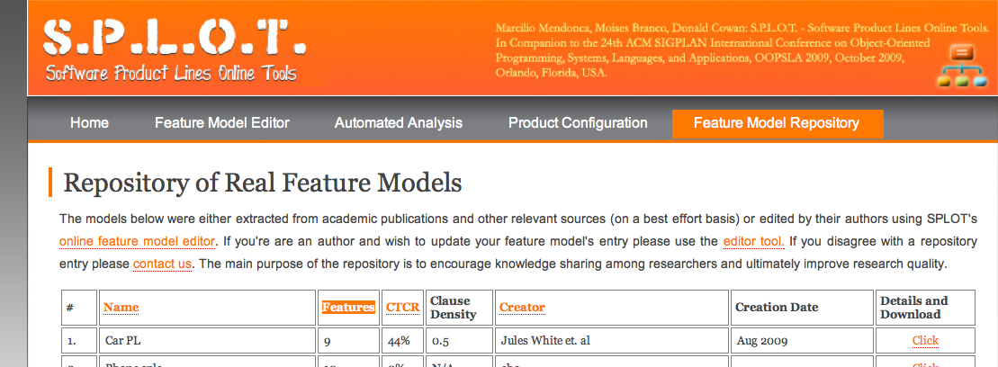
Preparing Data
We need
2 feature models, with already added constraints
We use 2 feature models from SPLOT Feature Model Repository
Graph Product Line, by Don Batory
Weather Station, by Pure-Systems
Most of the features are terms that are defined in Wikipedia, we use the first paragraph of the definition as the feature’s description

Slide 24
Experiment Settings
There are 2 types of experiments
Without Feedback
With Limited Feedback
Generate Training & Test Set
Optimize, Train and Test
Result
Generate Initial Training & Test Set
Optimize, Train and Test
Check a few results
Training & Test Set
Result
Add checked results to training set;
Remove checked results from test set

Slide 25
Experiment Settings
For each type of experiment, we compare 4 train/test methods (which are widely used in data mining fields)
1. Training Set = FM₁, Test Set = FM₂
2. Training Set = FM₁ + A small part of FM₂, Test Set = Rest of FM₂
3. Training Set = A small part of FM₂, Test Set = Rest of FM₂
4. The same as 3, but do iterated LU training

Slide 26
What do the Experiments for?
Comparison of the 4 methods: Can a trained classifier be applied to different feature models (domains) ?
or: Do the constraints in different domains follow the same pattern?
Comparison of 2 categories: Does limited feedback (an expected practice in real world) improve the results ?

Slide 27
Preliminary Results
(Found a bug in implementation of Method 2 – 4, so only run Method 1)
Feedback strategy: constraint and higher similarity first
Test Model = Graph Product Line
Test Model = Weather Station
 | Accuracy
Without Feedback | 83.95%
Feedback (5) | 86.85%
Feedback (10) | 88.73%
Feedback (15) | 95.45%
Feedback (20) | 98.36%
 | Accuracy
Without Feedback | 97.84%
Feedback (5) | 99.44%
Feedback (10) | 99.44%
Feedback (15) | 99.44%
Feedback (20) | 99.44%

Slide 28
Outline
Overview
Preparing Data
Classification
Cross Validation & Optimization
The Experiment
What’s Next

Slide 29
Future Work
More FMs for experiments
Use Stanford Parser for Chinese to integrate constraints mining into CoFM

